Slide 1
Instructional Framework: Ending

Slide 2
Instructional Framework
Starter
Engagement
Ending
HOW
WHAT
IPG
Core Action 1
Core Action 2
Core Action 3
IPG
Core Action 1
Core Action 2
Core Action 3
IPG
Core Action 1
Core Action 2
Core Action 3

Slide 3
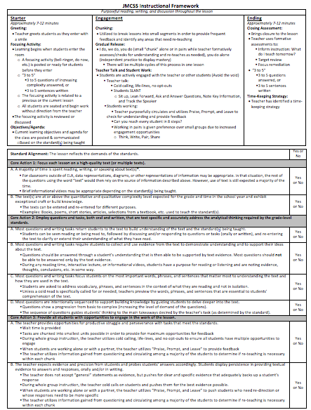
The “How”: Starter, Engagement, Ending
Measuring The “What”:
Core Actions 1, 2, and 3 of the IPG

Slide 5
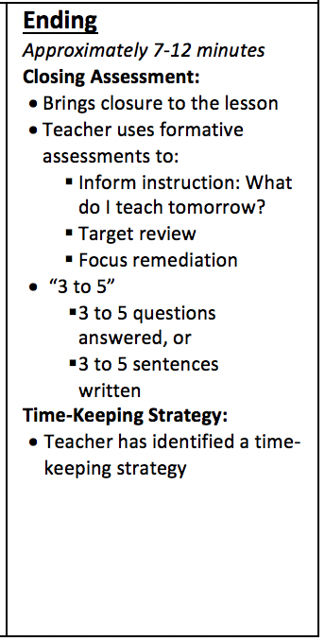
Ending: Overview
Closing Assessment
Time-Keeping Strategy

Slide 6
Closing Assessment
Brings closure to the lesson
Teacher uses formative assessments to:
Inform instruction: What do I teach tomorrow?
Target review: What do I need to reteach?
Focus remediation/enrichment: Which students need remediation or enrichment?
“3 to 5”
3 to 5 questions answered, or 3 to 5 sentences written to determine if students mastered the objectives communicated at the beginning of the lesson

Slide 7
Closing Assessment
Why?
Provides feedback to the teacher– did you teach what you intended to teach and have the students learned what you intended them to learn?
Assess progress on the objectives you set at the beginning of the lesson
Reduces forgetting and improves retention long-term memory by up to 50 percent
Opportunity to reinforce the key concepts/ideas within the lesson
Opportunity for students to reflect and draw conclusions
Leads to higher-order thinking
Creates an opportunity to smoothly transition from one lesson to the next lesson

Slide 8
Closing Assessment
How do you determine your closing assessment questions in advance?
What do you do if your lesson doesn’t progress as far as you had planned?
How is your closing assessment from one day related to your focusing activity for the next day?

Slide 9
Example of Closing Assessment
8th grade ELA
During this lesson the students began reading “The Ransom of Red Chief” from the “Tell-Tale Heart” unit in Learnzillion.
Based on today’s reading, refer to your text to answer the following questions:
When is this story being told in relation to the kidnapping? How do you know?
How much does the narrator know about what is happening? How do you know?
What words, phrases, or sentences reveal that something unexpected might happen? Give specific examples from the text.
Notice…
3 questions
Not overly detailed or time-consuming
Questions are based on the day’s reading and what the students learned
Questions are text-based
Based on the students’ level of mastery for each question, the teacher will make a determination of what to teach the following day.

Slide 10
Example of Closing Assessment
High School Biology
Based on the current day’s reading and discussion about the relationship between cell growth and cell reproduction, respond to the following questions:
The cell cycle has four main stages – G1, S, G2, and M. What occurs in the cell during each stage?
Differentiate between mitosis and cytokinesis.
Explain the importance of the cell cycle in eukaryotic cells.
Notice…
3 questions
Not overly detailed or time-consuming
Questions are based on the day’s reading/discussion and what the students learned
Questions are text-based
Based on the students’ level of mastery for each question, the teacher will make a determination of what to teach the following day.

Slide 11
Example of Closing Assessment
High School history class
During this lesson the students read and discussed poetry related to the “nature of war” during WWI.
Based on today’s reading and discussion about the “nature of war”, create your own poem that captures the “nature of war” during WWI.
Notice…
1 prompt
Not overly detailed or time-consuming
The prompt is based on the day’s reading and what the students learned
Based on the students’ level of mastery in response to the prompt, the teacher will make a determination of what to teach the following day.

Slide 12
Time-Keeping Strategy
Teacher has identified a time-keeping strategy
Why?
One less thing to think about!
Make sure you build in time for your closing assessment
Ensure mastery is assessed

Slide 13
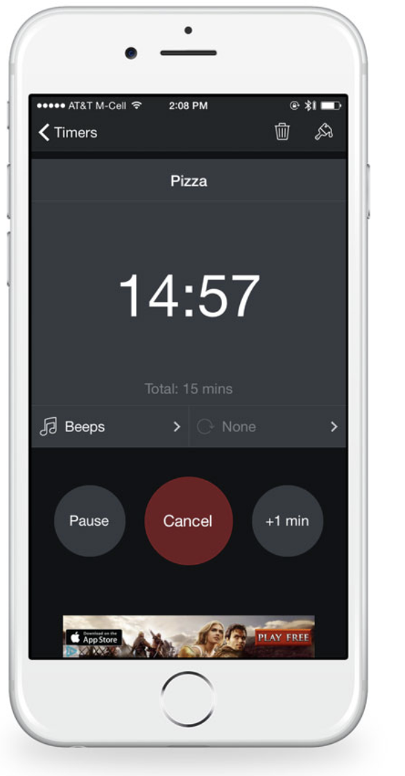
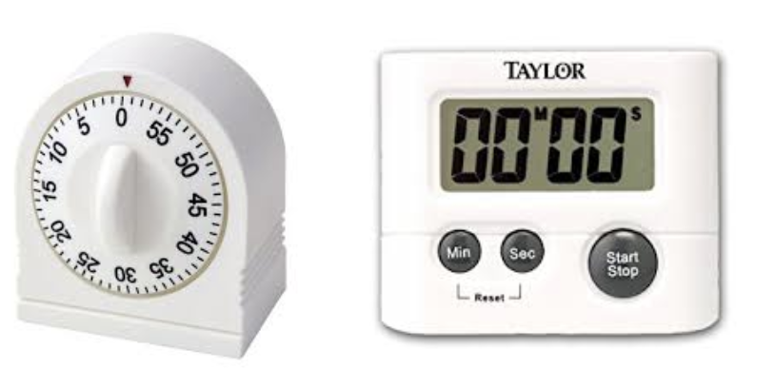
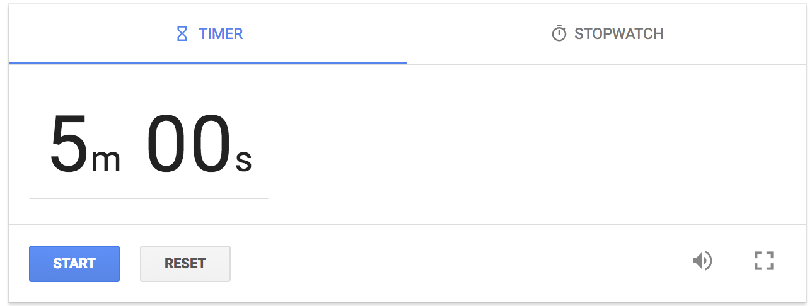
Examples of Time-Keeping Strategies
Timer on your phone
Countdown timer on your Promethean Board
Digital timer or wind-up timer
“Google” countdown timer online
Identify a student in your class who can “keep time” for you and notify you when there are 7 to 12 minutes remaining in class

Slide 14
Instructional Framework Feedback
Remember, it’s all about coaching!
The more coaching conversations we have about instruction, the more instruction will improve.
We owe you feedback to help you grow as a professional.
Our students deserve to attend schools where professionals are reflective about their own practices and open to feedback.
This includes teachers, principals, support staff…everyone.
Notes:
.

Slide 15
How would feedback be determined if a walk-through happened during a closing assessment?
Since it is during the “Ending,” that is the section of the lesson that would be looked at.
“How”
Then the IPG indicators would be looked at to determine the quality of the closing assessment.
“What”
1
2
3

Slide 16
Instructional Framework Feedback
8th grade ELA
During this lesson the students began reading “The Ransom of Red Chief” from the “Tell-Tale Heart” unit in Learnzillion.
Based on today’s reading, refer to your text to answer the following questions:
When is this story being told in relation to the kidnapping? How do you know?
How much does the narrator know about what is happening? How do you know?
What words, phrases, or sentences reveal that something unexpected might happen? Give specific examples from the text.
Does what I see/hear mostly align with this or not?
Were there missed opportunities?

Slide 17
Instructional Framework Feedback
Core Action 3: Provide all students with opportunities to engage in the work of the lesson.
The teacher provides opportunities for productive struggle and perseverance with tasks that meet the standards.
Wait time is provided
Tasks are chunked into smallest units possible in order to provide for maximum opportunities for feedback
During whole group instruction, the teacher utilizes cold calling, life-lines, and no opt-outs to ensure all students have multiple opportunities to engage
When students are working alone or with a partner, the teacher utilizes “Praise, Prompt, and Leave” to provide feedback
The teacher utilizes information gained from questioning and circulating among a majority of the students to determine if re-teaching is necessary within each chunk
?
The teacher expects evidence and precision from students and probes students’ answers accordingly. Students display persistence in providing textual evidence to answers and responses, orally and/or in writing.
The teacher does not accept “general” statements as evidence, but pushes for clear and specific evidence that adequately backs up a student’s response
During whole group instruction, the teacher cold calls on students and pushes them for the best evidence possible.
When students are working alone or with a partner, the teacher utilizes “Praise, Prompt, and Leave” to push students who need re-direction or whose responses need to be more specific
The teacher utilizes information gained from questioning and circulating among a majority of the students to determine if re-teaching is necessary within each chunk
?
Core Action 2: Employ questions and tasks, both oral and written, that are text specific and accurately address the analytical thinking required by the grade-level standards.
Most questions and writing tasks return students to the text to build understanding of the text and the standard(s) being taught Yes!
Most questions and writing tasks require students to collect and use evidence from the text to demonstrate understanding and to support their ideas about the text.
Questions should be answered through a student’s understanding that is then able to be supported by text evidence. Most questions should not be able to be answered only by the text evidence.
During any reading time, interactive lecture, or informational videos, students have a purpose for reading or listening and are noting evidence, thoughts, conclusions, etc. in some way. Yes!
Most questions and writing tasks focus students on the most important words, phrases, and sentences that matter most to understanding the text and how they are used in the text.
Students are asked to address vocabulary, phrases, and sentences in the context of what they are reading and not in isolation.
Unless a cold read is specifically called for or needed, teachers preview the words, phrases, and sentences that are essential to students’ comprehension of the text. Yes!
Most questions are intentionally sequenced to support building knowledge by guiding students to delve deeper into the text.
Questions show a progression from basic to complex (increasing the level of demand of the questions).
The sequence of questions guides students’ thinking to the main takeaways desired by the teacher’s task (as determined by the standard).
Yes!
Core Action 1: Focus each lesson on a high-quality text (or multiple texts).
A majority of time is spent reading, writing, or speaking about text(s)*.
For classrooms outside of ELA, data representations, diagrams, or other representations of information may be appropriate. In that situation, the rest of the questions using the word “text” would then rely on the source of information described above. However, use of text is still expected a majority of the time.
Brief informational videos may be appropriate depending on the standard(s) being taught.
Yes!
B. The text(s) are at or above the quantitative and qualitative complexity level expected for the grade and time in the school year and exhibit exceptional craft or build knowledge.
The texts can be entered and re-entered for different purposes.
Examples: Books, poems, short stories, articles, selections from a textbook, etc. used to teach the standard(s).
Yes!
Standard Alignment: The lesson reflects the demands of the standards
Yes or No?
6.RL.KID.1 Analyze what a text says explicitly and draw logical inferences; cite textual evidence to support conclusions.
6.RL.KID.3 Describe how the plot of a story or drama unfolds, as well as how the characters respond or change as the plot moves toward a resolution.
6.RL.CS.4 Determine the meaning of words and phrases as they are used in a text, including figurative and connotative meanings; analyze the impact of specific word choices on meaning and tone, including allusions to other texts.
Yes!
Yes
Yes
8th grade ELA
During this lesson the students began reading “The Ransom of Red Chief” from the “Tell-Tale Heart” unit in Learnzillion.
Based on today’s reading, refer to your text to answer the following questions:
When is this story being told in relation to the kidnapping? How do you know?
How much does the narrator know about what is happening? How do you know?
What words, phrases, or sentences reveal that something unexpected might happen? Give specific examples from the text.
Yes
Yes
Yes
Yes
Yes
Dependent on teacher actions in the room…did strategies such as “Praise, Prompt, and Leave” occur?

Slide 18
Ending: Recap
Closing Assessment
Time-Keeping Strategy

